Slide 1
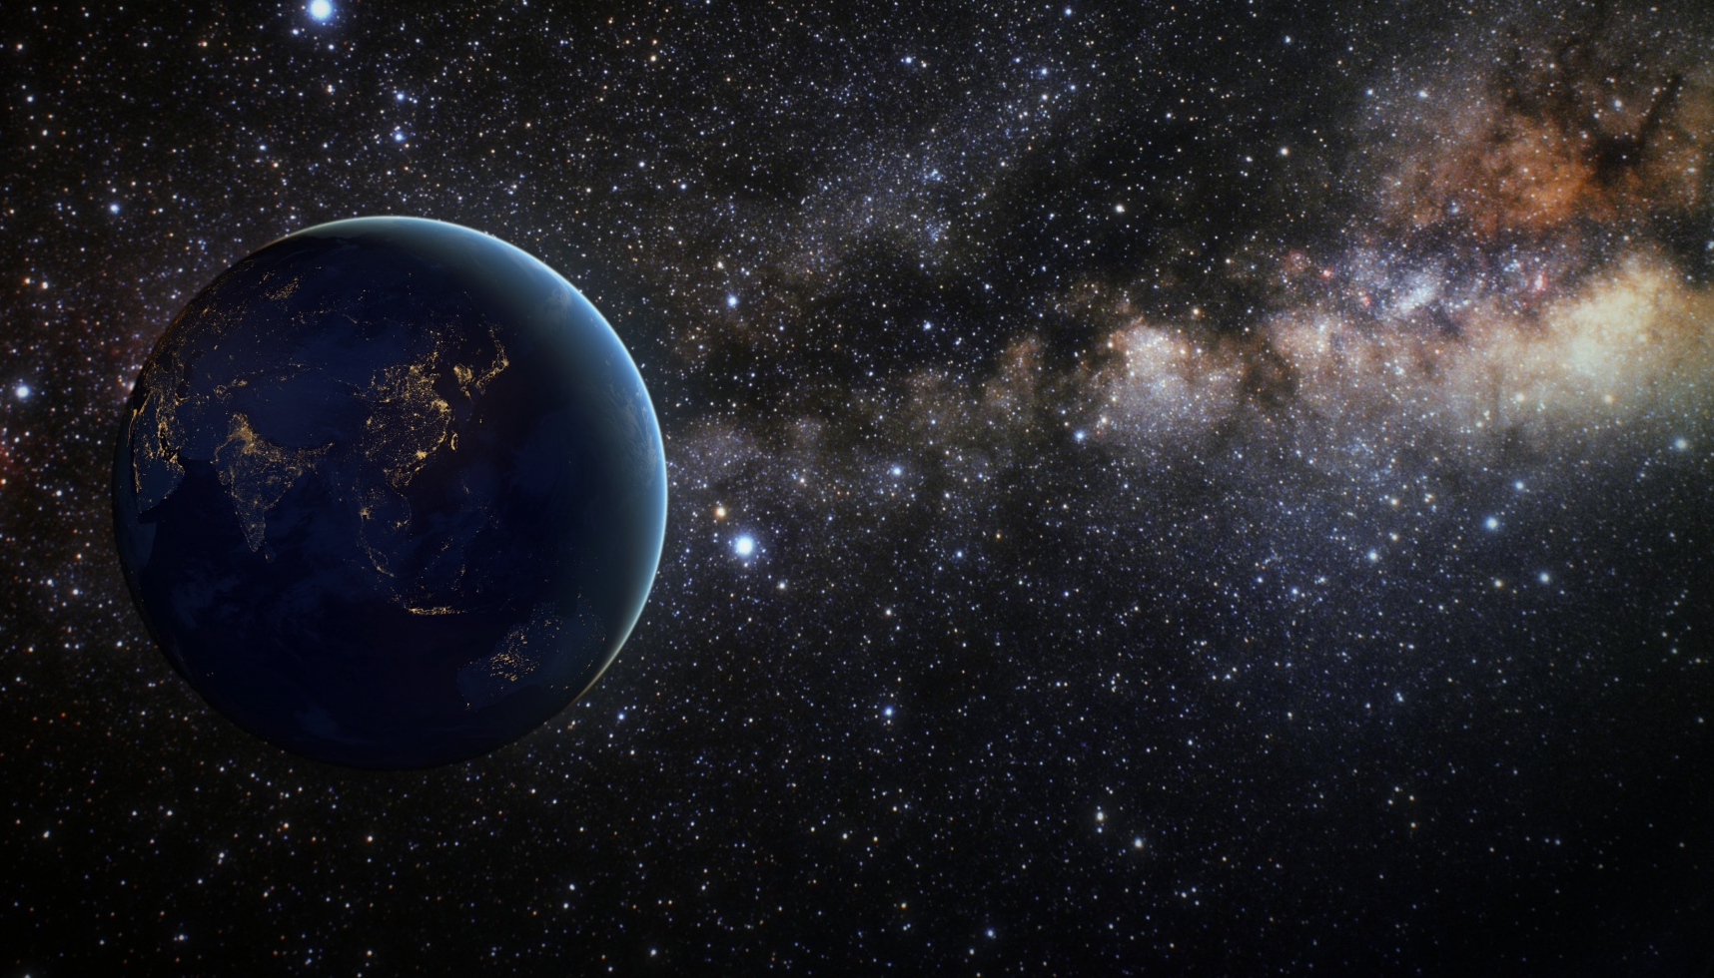
Immersed in the sound of space
Group: SFRJ

Slide 2
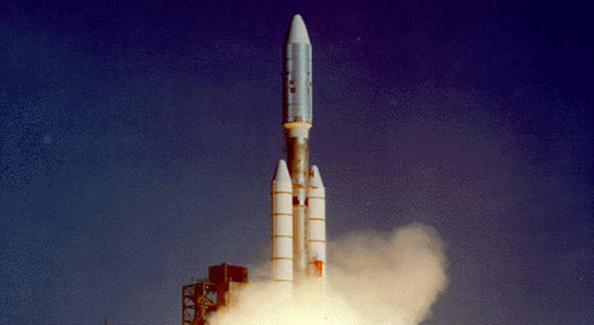
Inspiration
The Golden Record – a 12-inch gold-plated copper disk
115 images
a variety of natural sounds
musical selections from different cultures and eras
spoken greetings in fifty-five languages
Voyager 1 (September 1, 1977)
Voyager 2 (August 20, 1977)
Voyager 2 launch

Slide 3
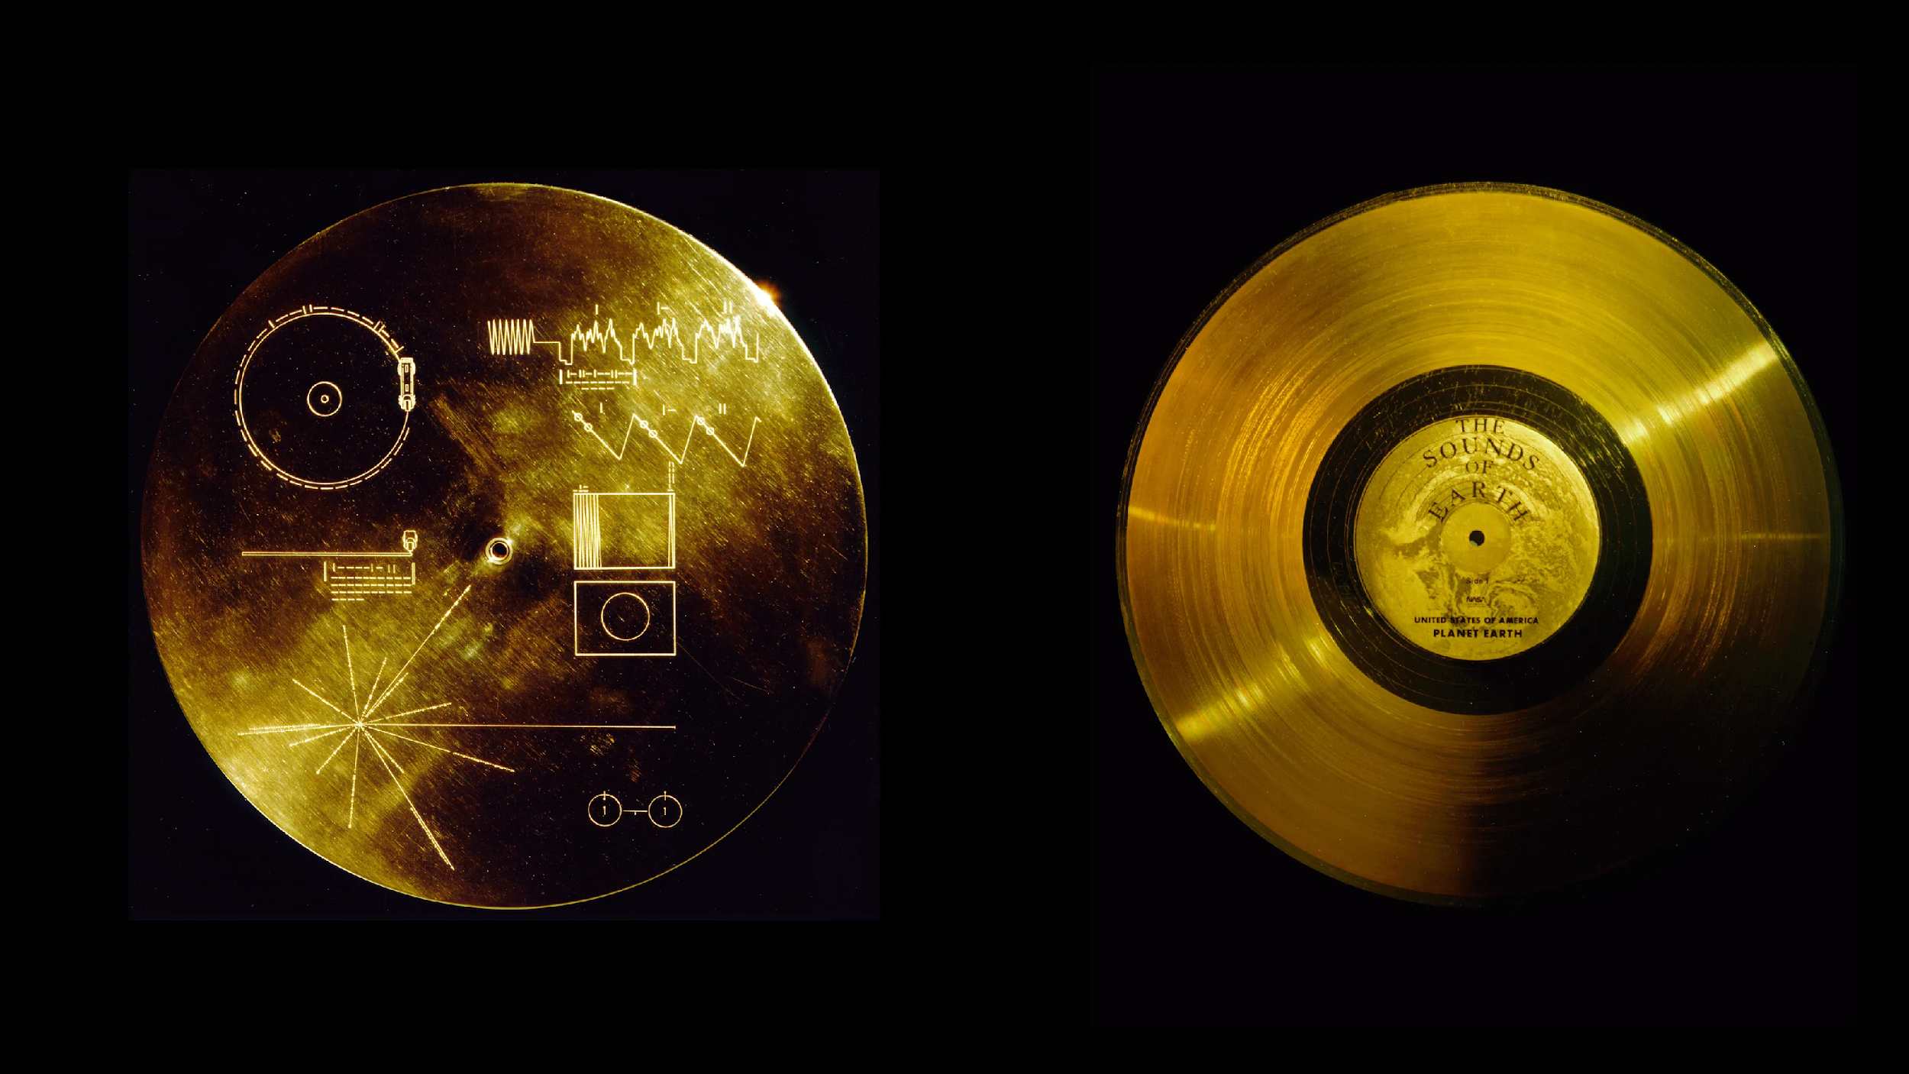

Inspiration
"The spacecraft will be encountered and the record played only if there are advanced spacefaring civilizations in interstellar space. But the launching of this bottle into the cosmic ocean says something very hopeful about life on this planet.” – Carl Sagan
Hearing space the way it may hears us
The Golden Record

Slide 4
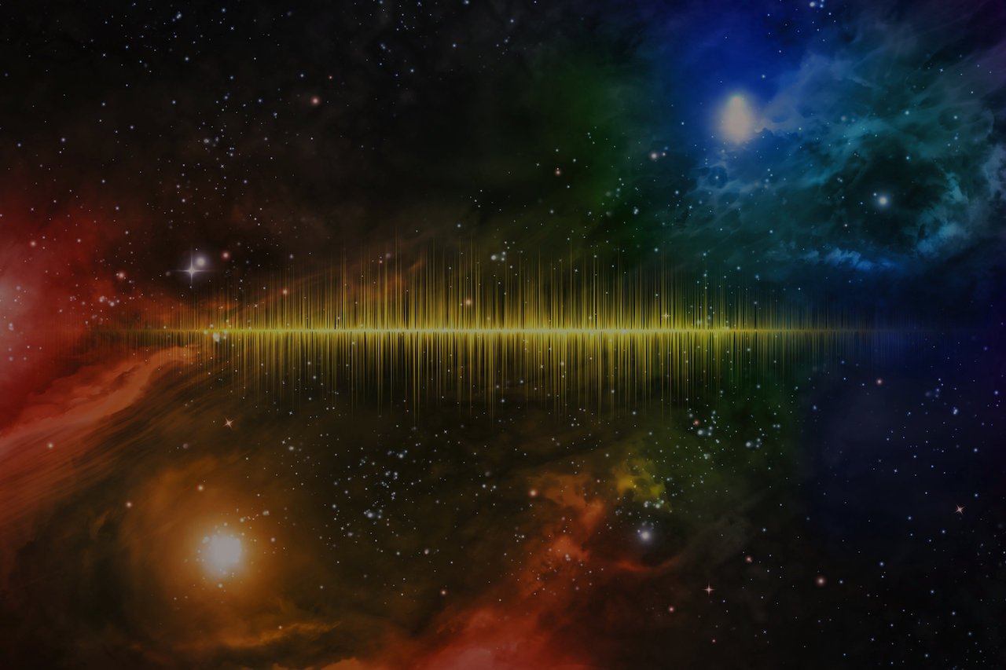
Seeing beyond pictures – the aim of the project
To help discover and feel the cosmos from Earth

Slide 5
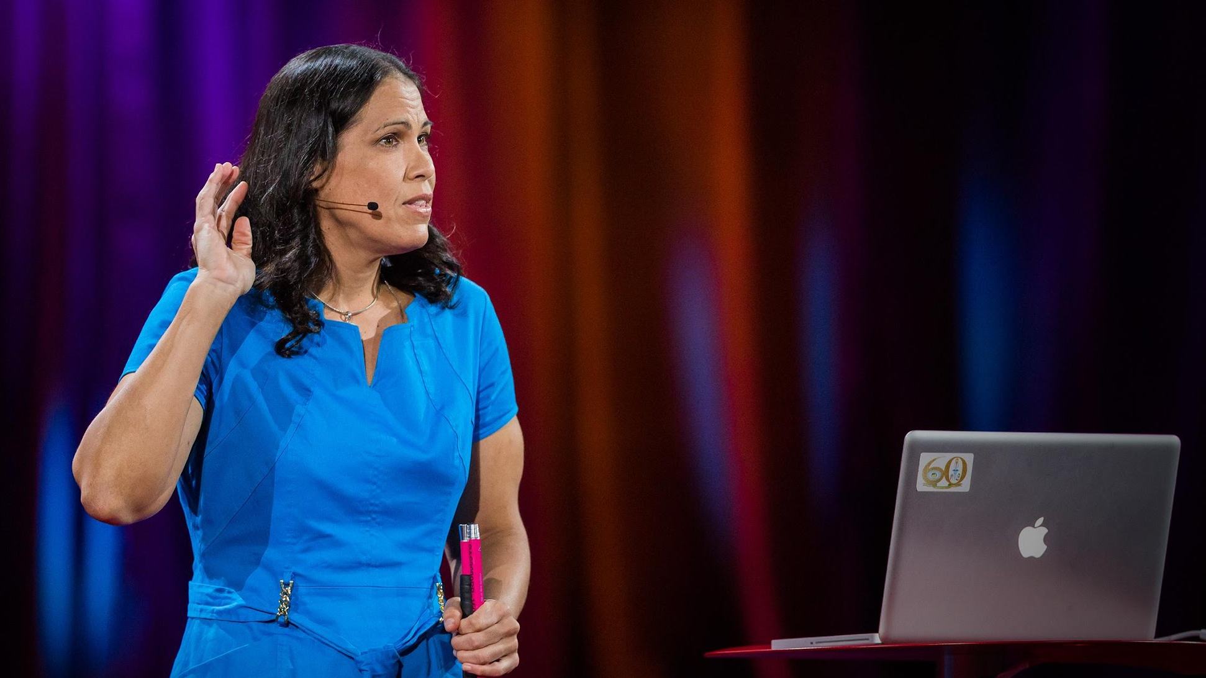
Wanda Díaz-Merced
Sonification – turning data sets into audible sound
Leader in increasing equality of access to astronomy and using audible sound to study astrophysical data
One of the 7 most trailblazing women in science

Slide 6
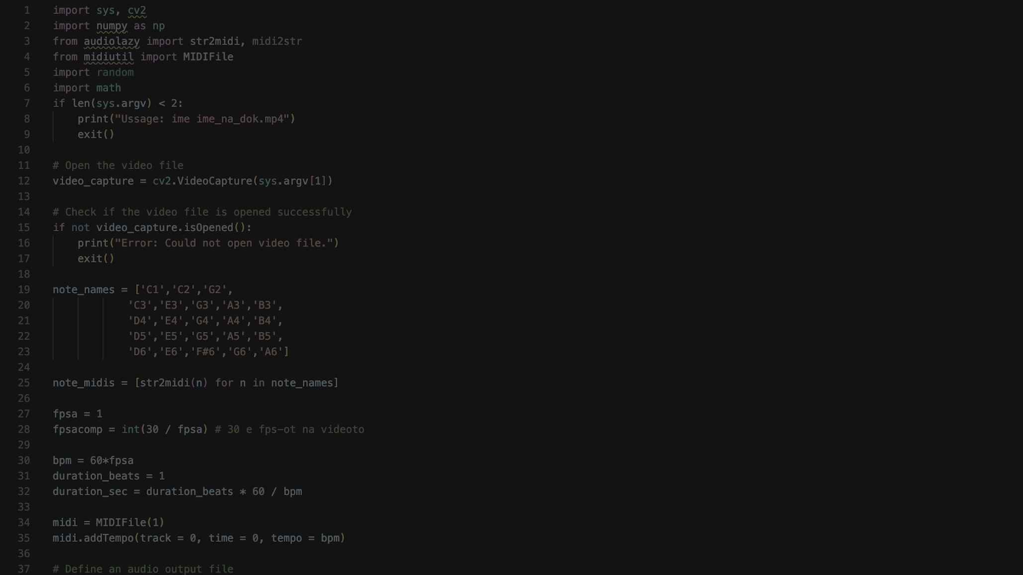
Realisation
mp4 video
frames
brightness
texture
color

Slide 7
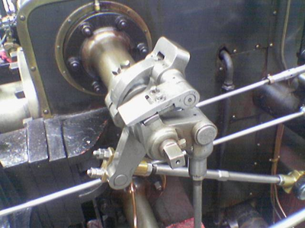
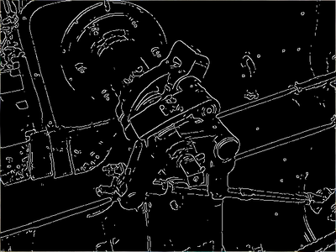
Brigtness and texture matrices
Brightness | Texture
Every frame is turned grey Resized to a 256 ⨉ 256 matrix Every cell is a 8-bit number containing the cell’s brightness intensity | Canny edge detection algorithm for recognizing patterns, edges and lines
Using the Canny edge detection algorithm example

Slide 8
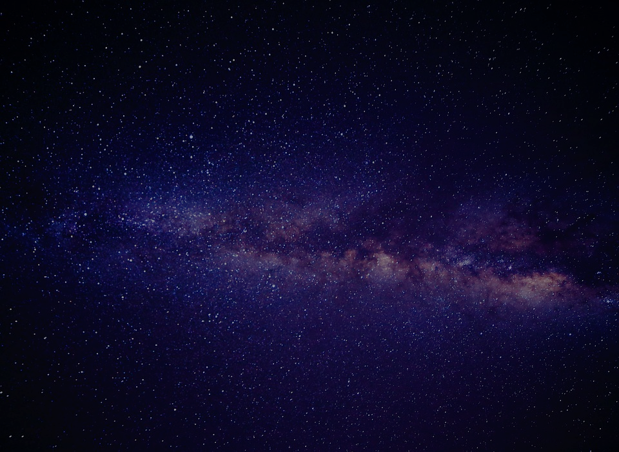

Finishing the audio
Brightness and texture matrices are turned into frequency arrays
Normalizing the audio signals
Extracting the mean color of the frame
Merging all audio signals

Slide 9
Testing the program
Now we will review the code and play a demo

Slide 10
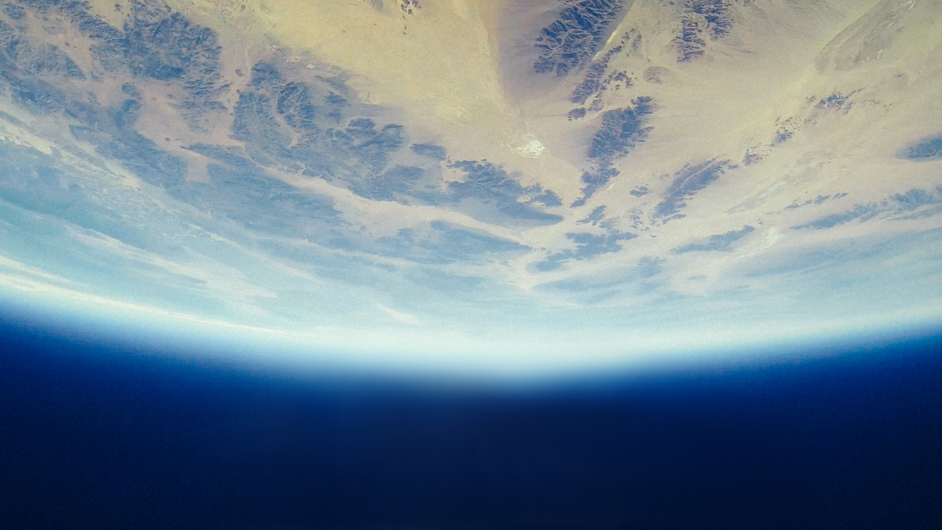
Questions?

